Slide 1
Summary: Biological Pathway Exchange (BioPAX) Ontology
BioPAX is an ontology for exchanging biological pathway data
Tutorial Website: https://github.com/cannin/biopaxTutorial
Introduction to the Biological Pathway Exchange (BioPAX) Ontology
BioPAX Basic Concepts
Visualizing BioPAX
Resources providing BioPAX-based data (e.g. Pathway Commons)
Introduction to Paxtools and Pathway Commons APIs
Paxtools Tutorial using the Paxtools playground website
Setting up Paxtools Maven-based Projects
Pathway Commons Webservice API playground
Additional Topics
BioPAX-related Software Ecosystem
Ongoing Developments
Research Problems using BioPAX data

Slide 2
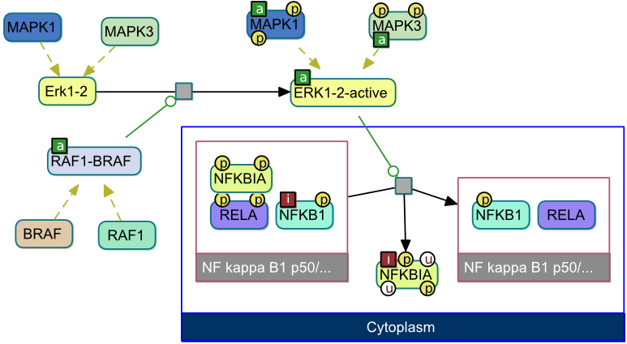
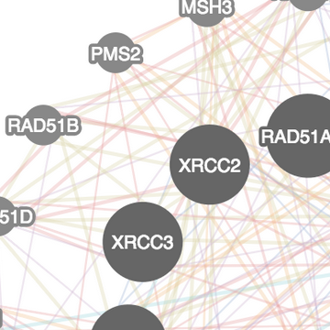
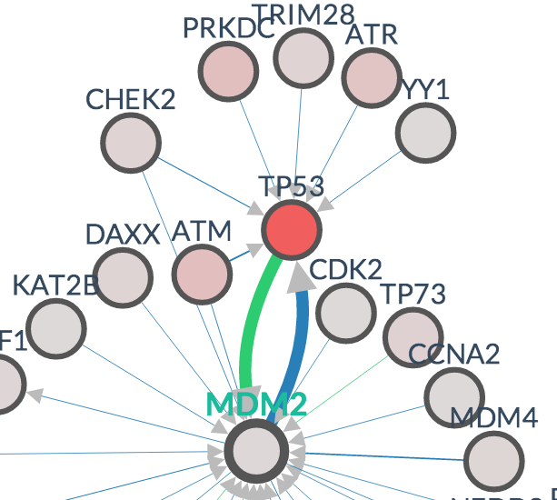
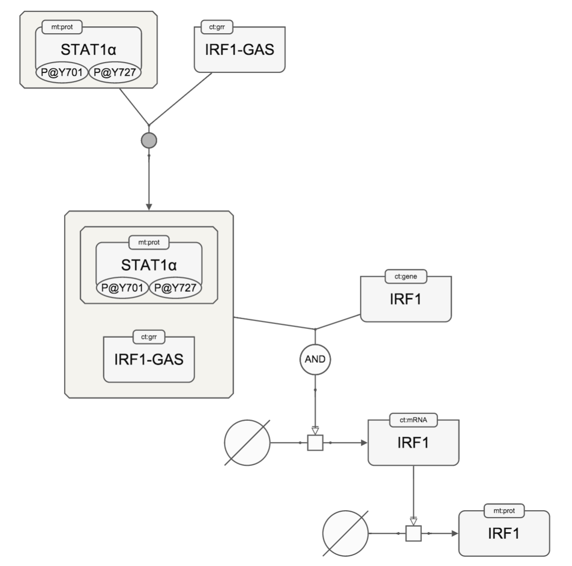
Visualization
ChiBE (desktop, detailed)
Cytoscape.js (web, general)
PCViz (web, simplified)
SBGNViz (web, detailed)

Slide 3
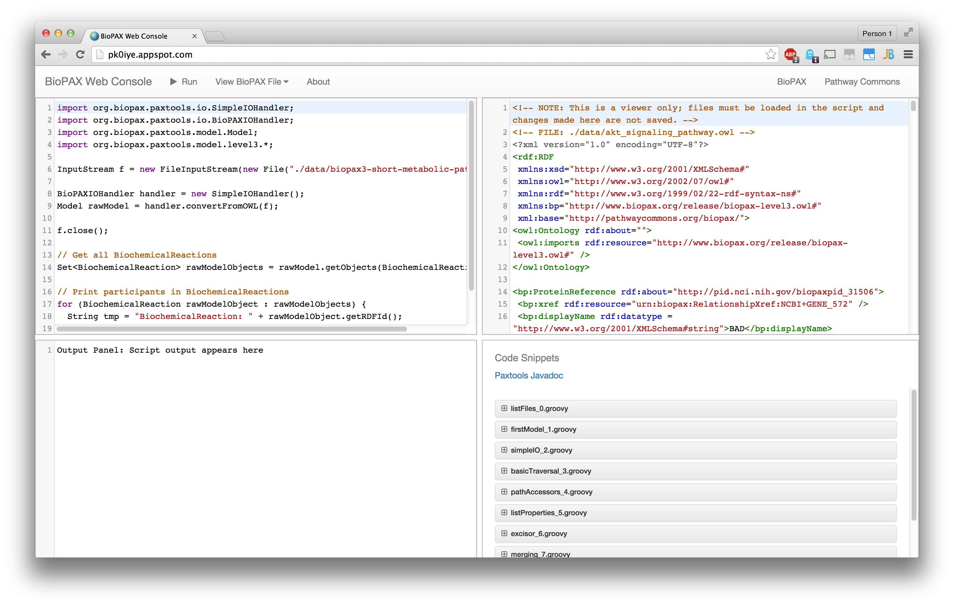
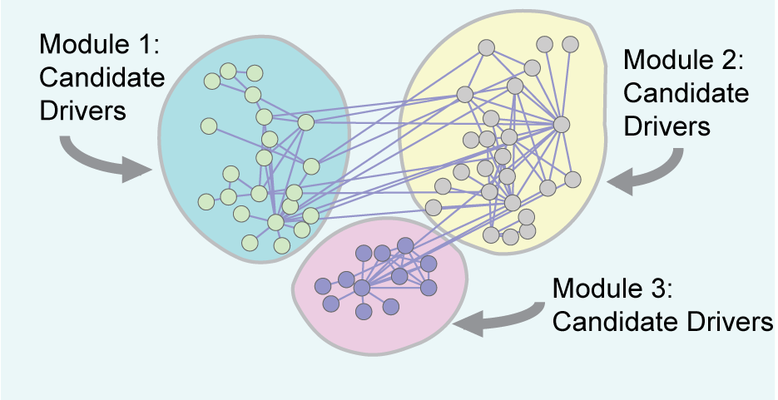
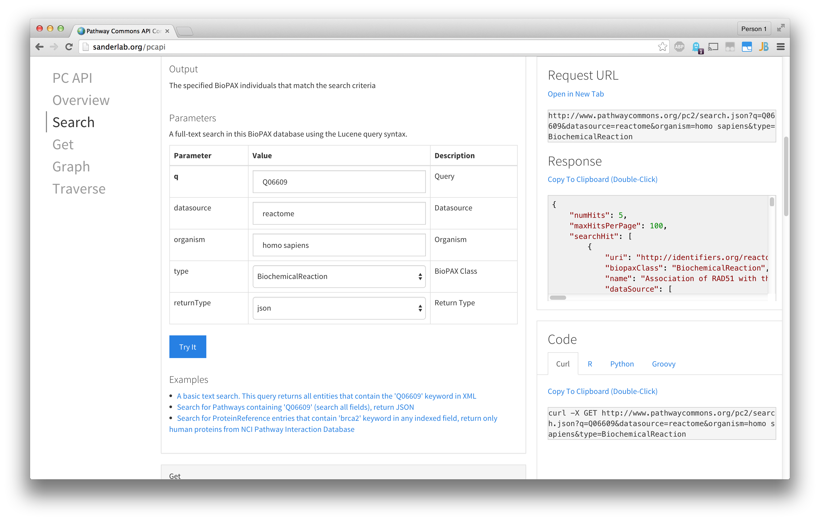
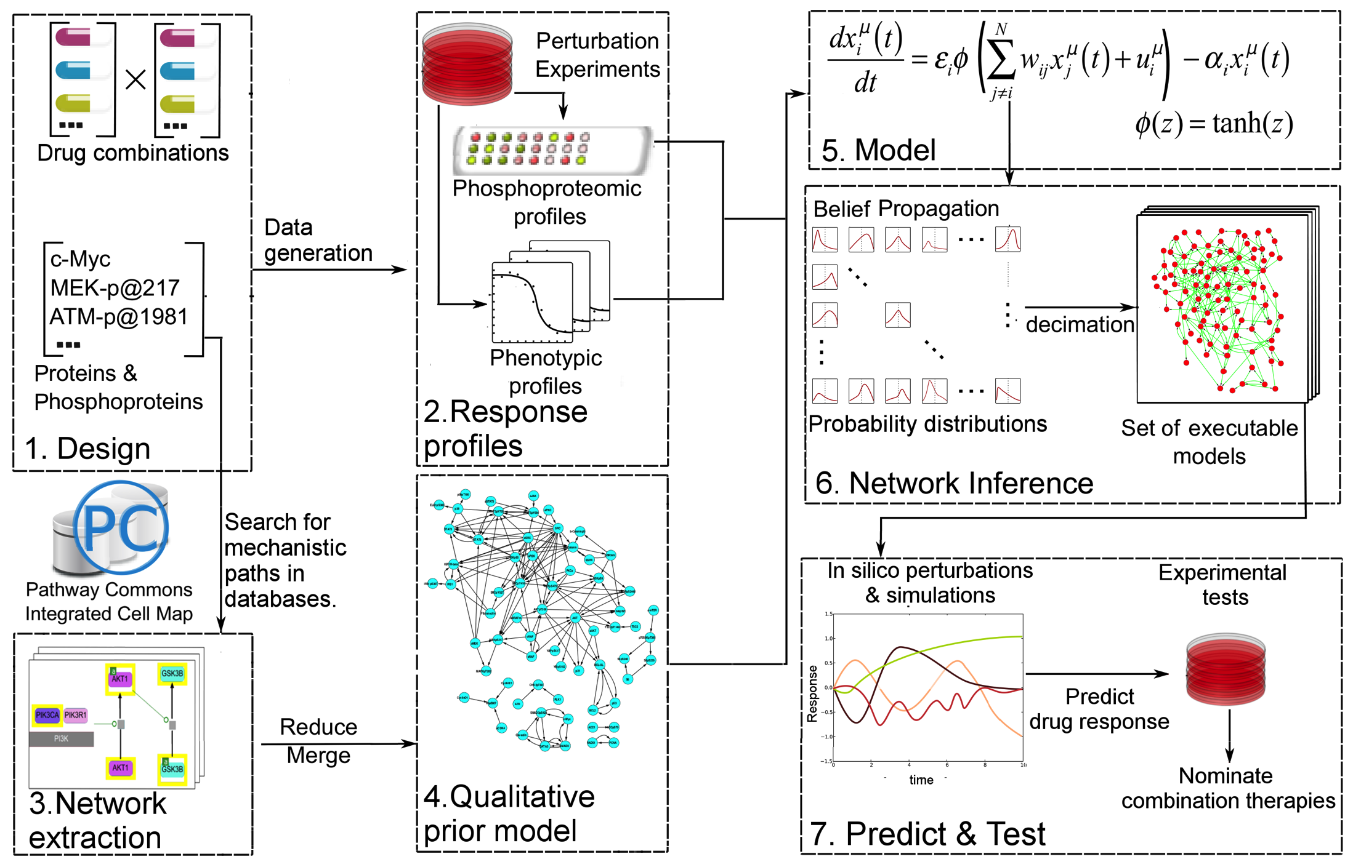
Playgrounds and Research
Playgrounds
Research
BioPAX/Paxtools
Identifying Disease Modules
Pathway Commons
Predicting Response to Drug Combinations

